Slide 1
Welcome to year 6

Slide 2
Meet the Year 6 Team…
Damson - Mrs Armitage & Miss Esher-Goodridge
Willow - Mrs Elliot-Smith & Mr Hurst
Mimosa - Mrs Gordon and Mrs Van de Merwe
Quince - Mrs Marlow & Mrs Anderson

Slide 3
UNIFORM
Jewellery should only consist of a watch and/or one pair of stud earrings
No make up or nail polish
Appropriate black school shoes (not trainers)
Black or grey socks for boys…black, grey or white for girls (black or grey tights)
PE kits need to be worn on Tuesday and Wednesday (on Forest school days change into uniform in the afternoon)
Please ensure long hair is tied back
For PE remove earrings or please cover with micro-pore tape
PE kit- Plain black tracksuit bottoms or non-lycra shorts (no Nike Pro style shorts please), green t-shirt, plain black hoodie or jumper (or school jumper please)

Slide 4
Belongings/equipment
Smart phones are no longer allowed in school. If your child needs a non-smart phone for walking home from school, please fill out a form from the school office. Phones will need to be handed to the office daily.
A pencil case that will fit in their tray.
All children should have a water bottle with them at all times
Do encourage to bring a waterproof as we will always try to get children outside, even in light drizzle
Healthy snacks are encouraged and your child must place this in the classroom’s Healthy Snack Box (not taken from their lunch box)

Slide 5
PPA – Wednesday morning
Woodland Wonders
Lead by Mrs Clack and Miss Gore. You will receive a letter prior to your child’s class starting informing you of further details. Willow class is the first class, followed by Mimosa, Quince and Damson.
OR
Physical Education
Taught by CM Sports coaches
Covers Games and Athletics
French
Taught by Mrs Hepworth
SPaG
Taught by Mrs Longworth

Slide 6
Reading
      It is really important to develop reading stamina. Our expectation is, as in previous years, that the children read for at least 10 minutes every evening. We ask the children to complete the comments section with a quick summary of what they have read that day.
      Contributes to the housepoint total.
      We encourage pupils to read challenging texts of both fiction and non-fiction and vary genres/authors.
      Morning reading groups
      Library and link books can be changed every day after school. Our library day is Thursday.

Slide 7

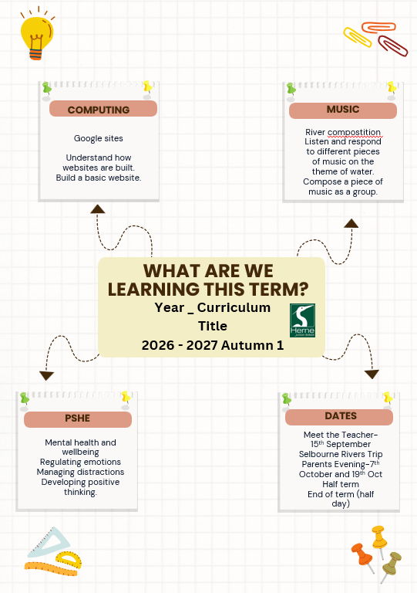
Curriculum letters
This term:

Slide 8

Harmony values
This term respect-house points for demonstrating our value.
Move up board for other values.

Slide 9
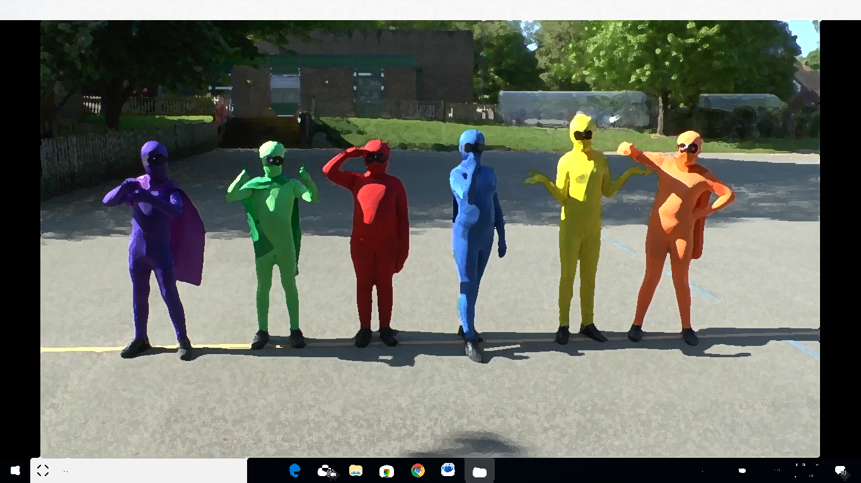
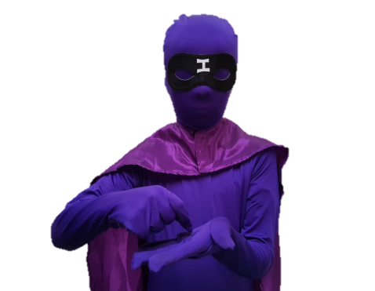
Independence
We encourage pupils to become more independent throughout this year, in preparation for their senior schools next year
It will help your child if they are encouraged to take on these responsibilities:
    Pack their own bag the night before
    Prepare their own lunches
    Have their own equipment in school
    Organise their own homework and timetables
    Complete their homework independently (and seek help via their teachers or parents/carers as needed)

Slide 10

Homework
Homework will be set each week.
Reading
Doodlemaths
Spellings
Throughout the year there will be a task or project, eg this week-speeches.

Slide 11
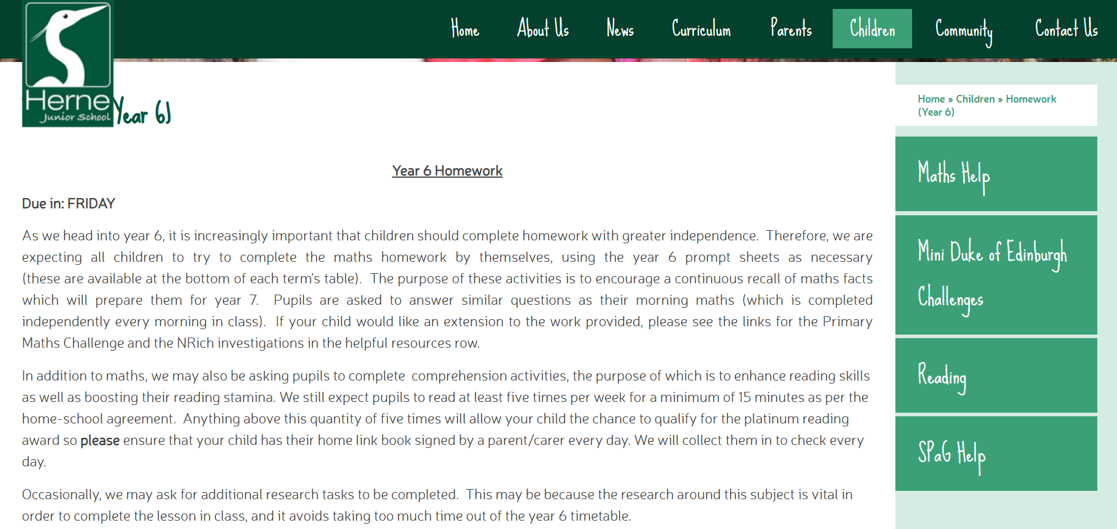
Homework support
Tabs have been added to the Year 6 homework page for maths and SPaG guidance.
There is also a recommended reading list for year 6 pupils.

Slide 12
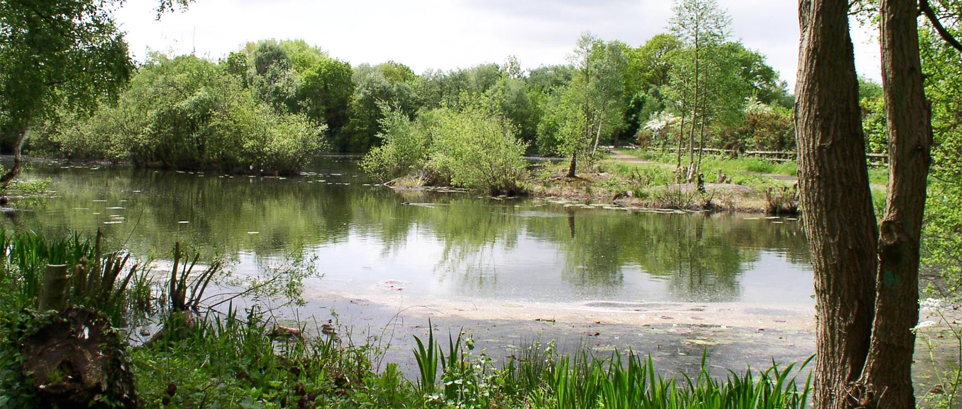
Dates
Selborne Field visit
      Willow and Quince – Monday 21st September
      Damson and Mimosa– Monday 28th September
Parents’ evening
      Wednesday 7th October and Monday 19th October
SATS week
      For the week commencing 10th May 2027
      No holidays to be booked for this week please
      Further information will be provided during the Spring Term to discuss these further and how we will support your child
IRONBRIDGE
      A letter will be sent home with the details and price of this trip. There will be 2 groups:
      Group 1: Monday 14th June to Friday 18th June
      Group 2: Monday 21st June to Friday 25th June

Slide 13
Finally…
Please do join your class’ Whatsapp group where you can raise questions and clarify anything you are unsure of. ☺
You are welcome to contact us via email through the school email and the office will forward it to us:
admin@hernejunior.com
Remember we are promoting INDEPENDENCE this year so we would really encourage your child to use their voice.

