Slide 1
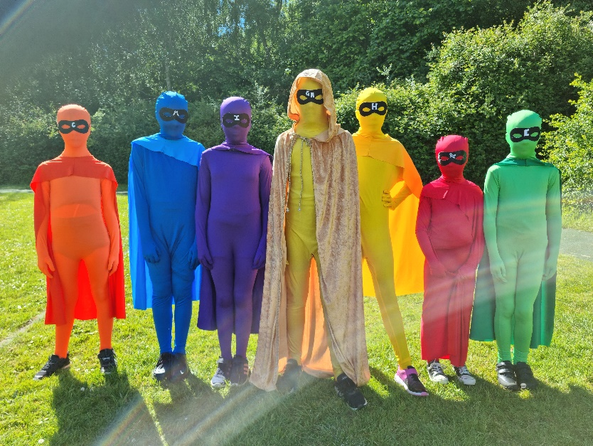
Herne Junior School
Year 3
Knowing every child,
Inspiring every mind,
Achieving every day.

Slide 2
Year 3 Team
Ash- Mrs C Tigwell (Year Leader)
Miss L Pittaway (Trainee Teacher)
Mrs A Nayton (LSA)
Fir- Miss H Jordan-Norris (teacher)
Mrs J Matthews (LSA)
Elm- Mrs H Keenan (teacher)
Mrs Y Lacey (LSA)
Oak- Mrs T Mackenzie (teacher)
Mrs I Kopeichycov (LSA)

Slide 3
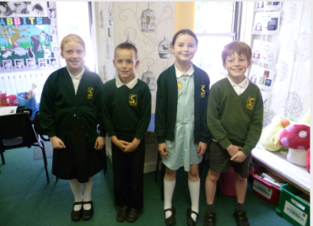
Daily Uniform
Please make sure that all uniform is fully named and regularly checked that the name is still present
Black school shoes (not trainers)
Long hair tied back
Simple stud earrings
No nail varnish
Please see the School Uniform Policy for more information (on our website)

Slide 4
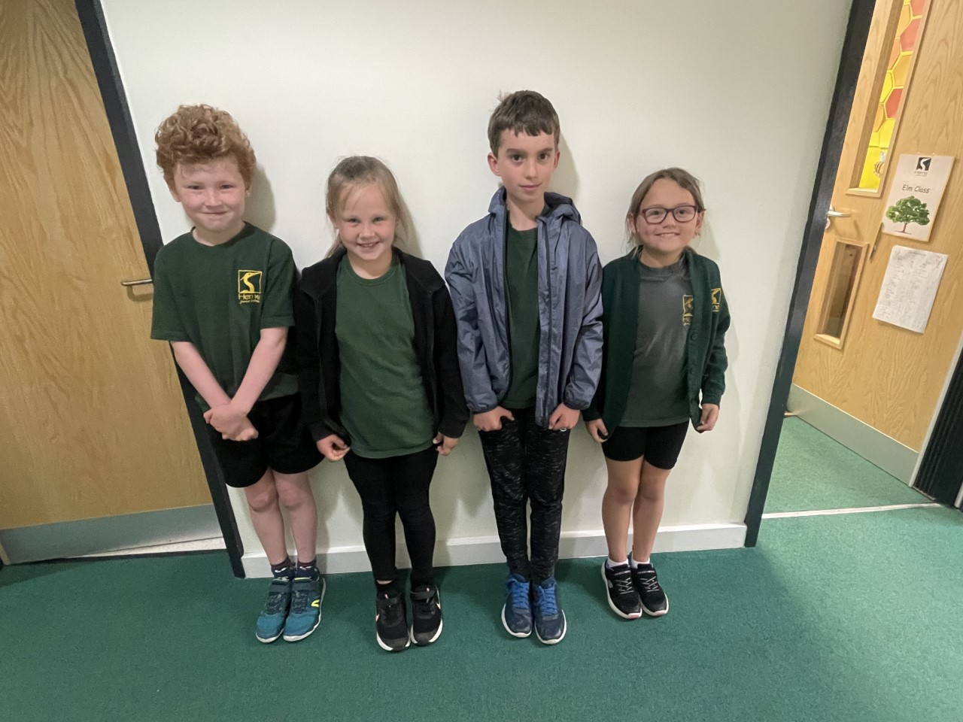
PE Uniform
Please provide your children with the following named items of uniform:
  Black shorts and/or tracksuit bottoms
  Herne green PE top (does not need to have the school logo)
  Black zip jumper or hoodie
  Black plimsolls for indoor PE
  Plain trainers for outdoor PE
Long hair must be tied back and all jewellery removed or taped
Children to come to school in their PE uniforms on a Tuesday and Thursday

Slide 5
Woodland Wonders
Children will take part in 9 weeks of Woodland Wonders throughout the year. An email will sent to you with further information for this.
To ensure your child is comfortable, warm and prepared, please send your child to school with appropriate clothes for Woodland Wonders and the season. There is no such thing as bad weather, just poor kit. We will be outside come rain or shine!
They are likely to get muddy and/or wet so it must be separate to their school uniform.
We suggest they have a bag for their boots/wellies and a bag for their Woodland Wonders clothes. Please ensure that all items including their bag are named.
If you think any of this will be a problem, please speak to your child’s class teacher in advance of them starting Woodland Wonders. We are able to support with some items.

Slide 6
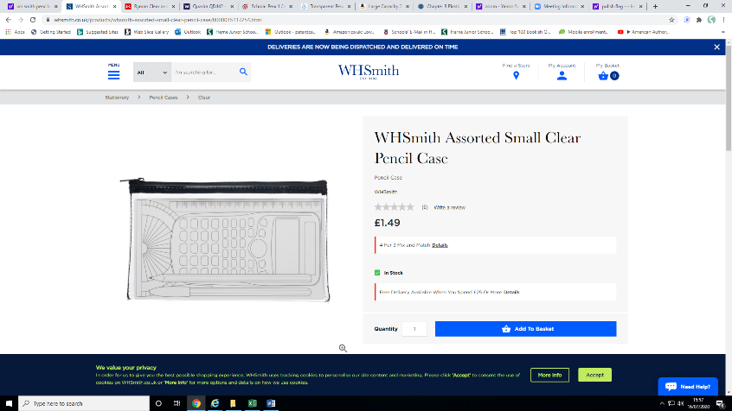
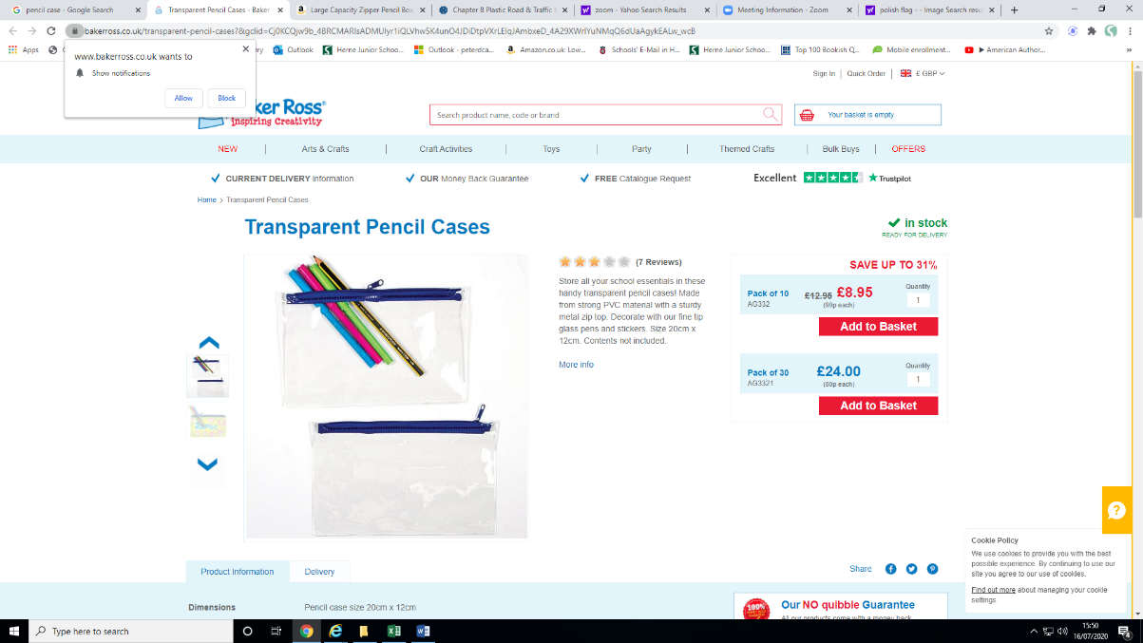
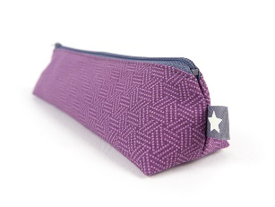
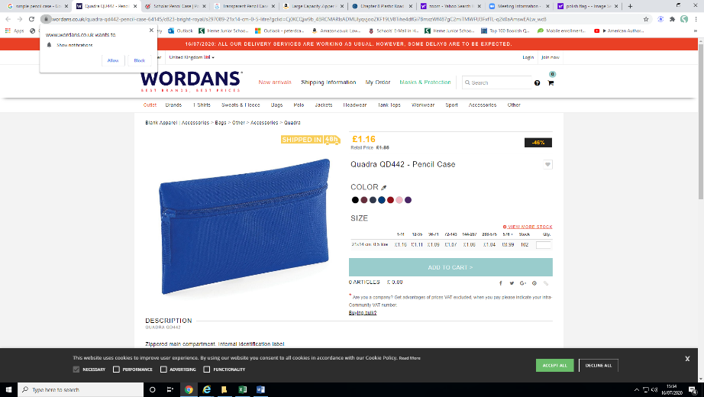
Water Bottles, Snacks & Bags
Please make sure they are all clearly named and please check regularly and rename if needed!
Healthy snacks only (e.g. fruit/vegetable based). We are a nut-free school, so please check the snack first.
A small pencil case, including colour pencils (6-12 colours), small ruler (6 inch), rubber, pencil sharpener & a glue stick. Herne will provide writing pencils and pens. Please check this regularly throughout the year and top up as necessary.
Please use a suitable sized bag, due to limited space in the cloakroom and classrooms. There are 120 children with school bags and the cloakroom needs to stay tidy. Draw string bags are best!

Slide 7
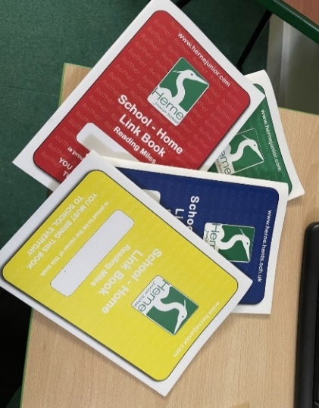
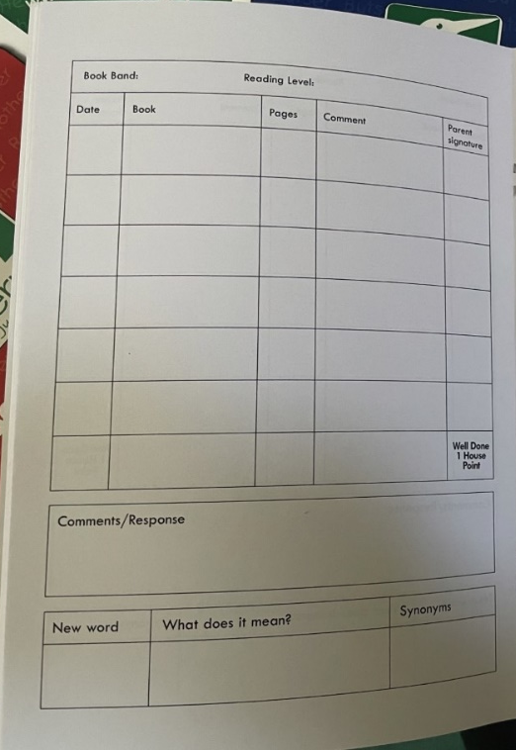
Reading
Children are expected to read and record a minimum of 5 days each week for at least 10 minutes a time.
Library books are also available to take home and you can visit our library with your child after school. Each class has a timetabled slot to visit during the week.
We use the recorded reading in the School-Home Link books to calculate the children’s reading miles. These are rewarded every term with a certificate (averages 6 times reading per week).
We also offer a RWInc programme for children who need additional support with phonics - 8.50-9.30.

Slide 8


Homework
Set on a Friday, completed by the following Friday. All homework is digital.
Spellings – a list is set on Spelling Shed to be practised which relates to our daily spelling practise in class. There are 5 ‘games’ required each week. Children are encouraged to then apply those spellings in different ways to ensure an understanding of their use. Evidence for this is not needed in school.
Times Tables Rock Stars (TTRS)- children are set sessions (10 garage) to be completed each week. As the children become more confident, Studio sessions will be added to this expectation, starting in the Spring term.
All homework will be monitored online and will be used to assess progress.
Please speak to your class teacher if this becomes a challenge for you as alternatives can be offered.

Slide 9
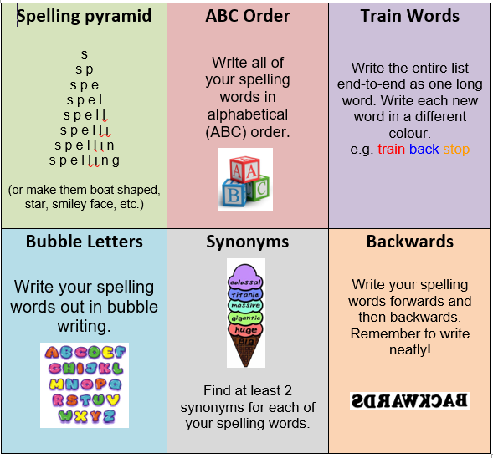
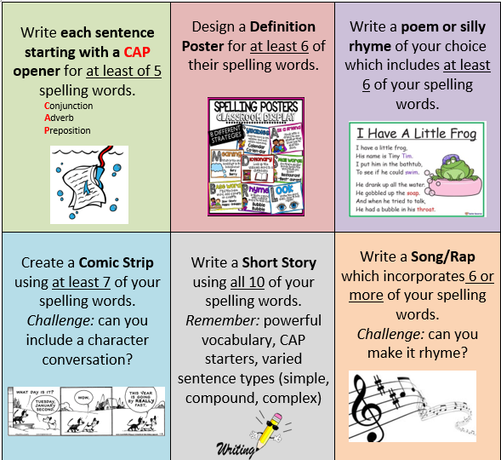
Optional methods for practising and embedding spellings ☺.
These can be found on the school website.
(Children tab - Homework (Y3))
https://www.herne.hants.sch.uk/page/?title=Homework+%28Year+3%29&pid=147
Information relates to current Year 3’s and will be updated before September.

Slide 10
Special Values Time
Tickets are earned when the children reach the top of the values board and tickets are then randomly selected from the pot on Friday.
The chosen child can attend Special Values lunch, get extra time on the adventure play and receive other privileges in class.
House Points
Children earn house points throughout the year in recognition of hard work, behaviour and just being amazing! We focus on one of our values per half term.
The house with the most points will win a treat.

Slide 11






Our exciting Year 3 curriculum
Autumn - Environmental Detectives
Through looking at world maps, exploring the continents and significant countries, we identify similarities and differences to our home town of Petersfield and a village within the Amazon Rainforest.
Spring - A Journey Through the Ages
Let’s head back in time to the years before written records! Starting in the Stone Age, we learn about significant achievements and legacies that have helped shaped our lives today.
Healthy Heroes
It’s time to put on our capes and help the world (or just ourselves!) become Healthy Heroes. We delve deep into the importance of diet and exercise and how these help us to lead an active, healthy lifestyle.
Summer - Rocking Romans
Continuing our historical learning, we place the Romans in history and develop our chronological awareness. Who were the Romans? When and why did they invade? How are our lives different today because of them?

Slide 12
Theme & Planned Trips
Environmental Detectives (Gilbert White’s House)
A Journey Through the Ages (The Heath with Petersfield Museum )
Healthy Heroes (Healthy Hero Day- dress up)
Rocking Romans (Rainbow Theatre)

Slide 13



Whole Class Reading
Throughout the year, we will read and explore a variety of engaging, quality texts.
To ease the children into the year and teach key comprehension skills, we will be starting the Autumn term with Phonics recap and Reading Explorers.
For our first book, bringing a link to our theme Environmental Detectives, we will be reading Lob, by Linda Newbery.
Spring text- Matilda, by Roald Dahl
Summer text- The Leopard in the Golden Cage,
by Julia Edwards

Slide 14
Parent Helpers
Readers – any help is appreciated. We really do rely on this so that every child can read to an adult in the week. This could be grandparents…..anyone who is free!
Art and DT days
Trips
DBS forms required (contact the office for further details)
Please approach your class teacher with your availability
Any and all help is extremely appreciated, so please let your class teacher know if you are available to help.

Slide 15
Your support is key
If we need to have a tricky conversation with you, this is because we need your support in order to help your child. We are a team and working together will achieve the greatest outcomes for your child and our class. If you feel that your child is struggling, let us know by emailing school via the admin email….we know happy children learn best.

Slide 16
Questions?
For any school-based questions, please contact the school office on admin@hernejunior.com or 01730263746.
Please join the class Whatsapp group. (Set up by the HAFS class rep.)
Keep an eye on the HAFS Facebook page and the Herne Junior School Facebook page.

