Slide 1
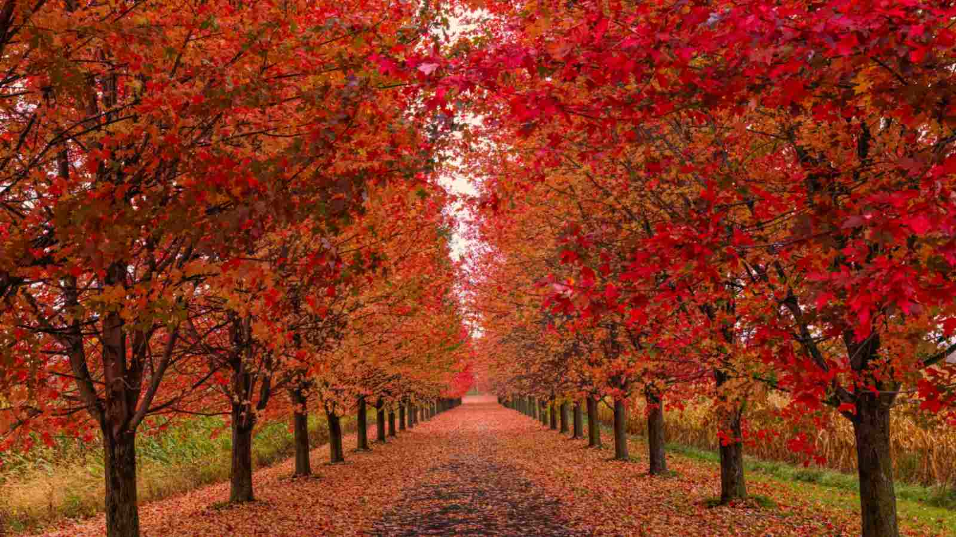
Welcome to Maple Class
Mr Zenklusen
Miss Heighes (Class LSA)
Mrs Evershed-Kirby

Slide 2
Curriculum
We have a themed approach to the curriculum so each of the topics will combine a number of subjects. Our themes are:
Our Earth in Space
  Winchester Science Centre (Tuesday 20th October)
Ancient Civilisations- Ancient Egyptians
  Haslemere Museum Workshop (Tuesday 1st December)
Living with the Power of Mother Nature
Bikeability (TBC)
Virtual Reality Workshop (Early Spring Term)
Ancient Civilisations- Ancient Greeks
  Rainbow Theatre (Summer Term)

Slide 3

PPA Thursday Mornings
CM Sports coaching (P.E. – Games and Athletics)
Woodland Wonders (November-January)
Mrs Burgess (SPaG/Maths)
Mrs Longworth (R.E/Music)

Slide 4
PE/ Swimming/Woodland Wonders– Monday and Thursday
Games (outdoors all year except for the Woodland Wonder term) on Thursday morning.
Indoor PE (gymnastics and dance) on Monday.
Indoor Swimming programme at Churcher’s College on Monday mornings February-March.
Please send children into school wearing their PE kits on Monday and Thursday. This should be a plain green t-shirt, plain black tracksuit bottoms or shorts, plain black hoodie or jumper (or school jumper please).
For safety- earrings need to be removed and hair must be tied up if shoulder length or longer on these days.
Children need to have appropriate clothes for Woodland Wonders. (Waterproofs tops & trousers, thermals, socks, coats, waterproof wellies/ boots) Children must bring in school uniform to change into afterwards.

Slide 5
Reading at home
“Reading is the key.” Daily Reading is 10-15 minutes, 5x a week minimum. Daily Reading will be monitored through the signed Home-link books.
We recommend that the children read their school colour banded link book but you may wish to intersperse this with other books too. Every child may borrow up to 2 books from the link and 2 from the Library. Unless they are a free reader then they can have 3 from the library.
The Library and Link are open after school everyday 3.30-4.00pm for you to visit with your child.
Use questions from link books to support your child with comprehension as this is a vital part of their reading development.
Our website also has suggestions and support.

Slide 6
Homework – Spellings and Tables
Weekly spellings – Will be given out on a Friday. There will be a weekly spelling test (usually Friday). We will only ask for evidence of spelling homework if a child’s test scores become a concern.
Times Tables- If your child is assessed as being very competent in this area, they will be asked to continue practising their times tables in a way that suits them. This is to ensure that their rapid recall of the facts remains. If we feel that your child needs to continue to have targeted practice, then they will be given a weekly times table to learn. This will be on the weekly homework sheet. All children will be tested weekly.

Slide 7
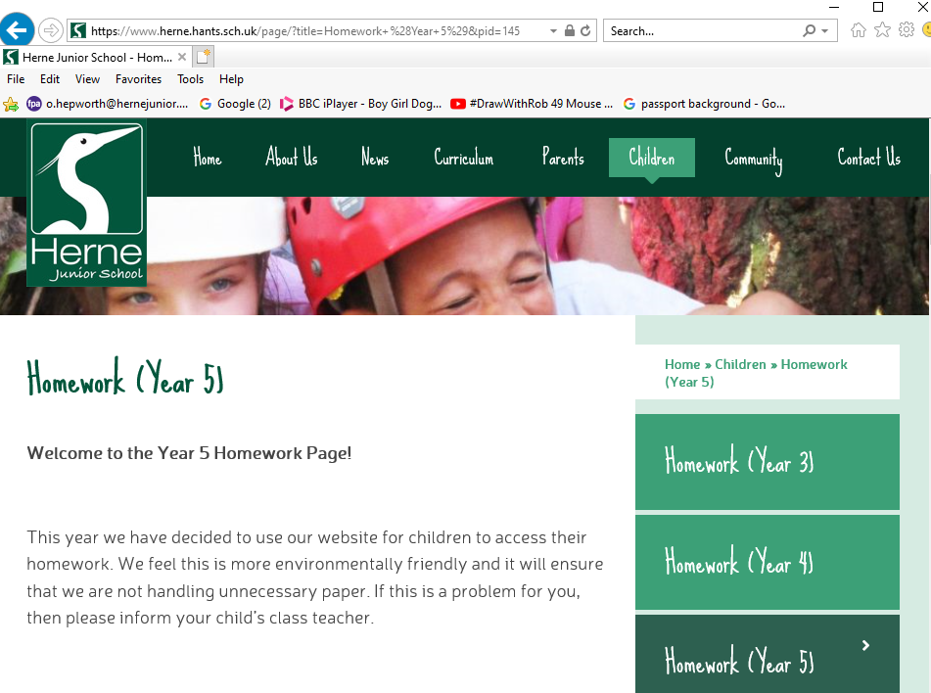
Other Homework Tasks
Weekly tasks should be handed in on Friday.
Weekly tasks may include:
Maths, SPaG, Reading
comprehension, Learning key
facts and theme linked
projects.
Please complete tasks neatly in Homework books using pencil.
If children are struggling, then bring it in and encourage them to speak to their teacher before Friday.
https://www.herne.hants.sch.uk/page/?title=Homework+%28Year+5%29&pid=145

Slide 8
Miscellaneous
Please name everything!
Healthy Snacks- fruit or healthy cereal bar/crackers only.
Please no nut based snacks.
Water bottles and snack boxes.
Coats and jumpers.
Always be prepared for all weather. We do like to get the children outside whenever we can!
Please name all items brought in. Even socks.
In order to keep children safe CCTV has been installed in communal areas and along the outside path.
Please can you make sure any technology children use is being monitored especially for calls and chats.

Slide 9
And Finally…
Please contact the school office if you have any questions, queries, or worries.
If you would like to volunteer your help with reading, we would greatly appreciate it. (Please be aware for any regular volunteers we need you to complete a DBS check.)
DT days and trips will pop-up, so please keep an eye out for the letters.
Parents’ Evening will be in October.
Any questions?
Thank you for coming.

