Slide 1
Relationships, Sex and Health Education Parent/Carer Information 2023
Notes:
Good evening, afternoon or morning, depending on when you are watching this!
Welcome to the Relationships, Sex and Health Education Parent/Carer Information Presentation. The Relationships, Sex and Health Education curriculum is extremely broad including units on mental wellbeing, online safety, friendships, peer pressure, families and much, much more. However, this information event, will be looking in detail at specific areas of our programme of study at Herne: namely Puberty and Relationships and Sex Education.
So, we will start with a few welcomes to begin with:
I am Mrs Hepworth (Olivia Hepworth) and I have been at Herne for coming up to 11 years this September. I have taught 7 of those years in Year 6. I have also been the Personal, Social, Health Education AKA PSHE) lead at Herne for 9 years, attended numerous PSHE courses in my time, planned many PSHE units including the Relationships and Sex Education curriculum at Herne for the last 8 years and am an extremely passionate advocate and champion for this subject.
Mrs Thakore (Belinda Thakore) is the other PSHE lead (although currently on Maternity leave) and has been at Herne for coming up to 10 years this September. She has taught all over the school and so has an extremely good knowledge of the curriculum across the years. She has also been the PSHE lead at Herne for 7 years, attended numerous PSHE courses in her time, planned many PDL units including the ‘Growing and changing’-Puberty unit and is also an extremely passionate advocate and champion for this subject.
So I think it is fair to say (without sounding like we are blowing our own trumpets!) that between the two of us, we are quite well versed in all things to do with the Relationships, Sex and Health education programme offered at Herne and we look forward to taking you through this information.
We know that as parents/carers you are first and foremost the most important teachers in your child’s/children’s lives which is why we feel it is so important to share with you our graduated, age appropriate programme of study and sensitive approach to teaching such important subjects. We welcome your feedback if you have any and we have put our details at the end of the PPT if you would like to contact us about anything mentioned here.
We appreciate there is a lot of information on the slides, so we encourage you to get yourself a drink, get comfy and pause the video whenever you need.
https://www.gov.uk/government/news/relationships-education-relationships-and-sex-education-rse-and-health-education-faqs

Slide 2
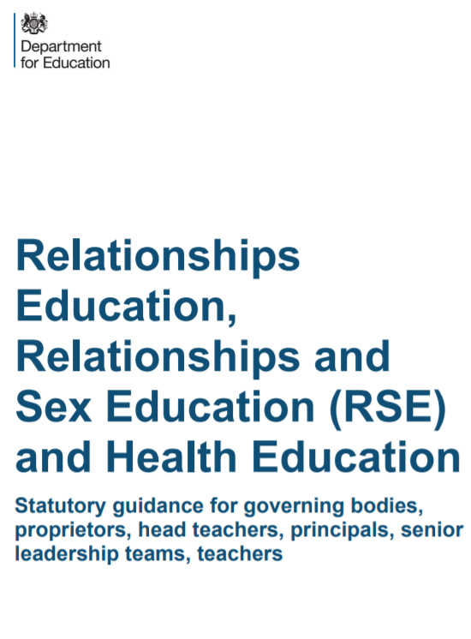
Department for Education’s (DfE) Guidance on Relationships Education and Sex Education (RSE) and Health Education
“The Relationships Education, Relationships and Sex Education and Health Education (England) Regulations 2019, made under sections 34 and 35 of the Children and Social Work Act 2017, make Relationships Education compulsory for all pupils receiving primary education and Relationships and Sex Education (RSE) compulsory for all pupils receiving secondary education. They also make Health Education compulsory in all schools except independent schools.”
Sex Education at Herne is taught in Year 6
Notes:
To begin with we will be looking at the statutory guidance from the Department for Education.
READ SLIDE
Year 4 Growing and Changing (Puberty) unit will begin after half term and Year 6’s Puberty and Reproduction unit will begin the week commencing Monday 15th May. You will receive letters to notify you of when your child’s class will begin this teaching and learning. This will give you time to either talk to your child beforehand if you want to and it will also explain why they might come home talking about menstruation or wet dreams!

Slide 3
DfE Secretary of State Foreward
“Today’s children and young people are growing up in an increasingly complex world and living their lives seamlessly on and offline. This presents many positive and exciting opportunities, but also challenges and risks. In this environment, children and young people need to know how to be safe and healthy, and how to manage their academic, personal and social lives in a positive way.”
“This is why we have made Relationships Education compulsory in all primary schools in England and Relationships and Sex Education compulsory in all secondary schools, as well as making Health Education compulsory in all state-funded schools.”
“The key decisions on these subjects have been informed by a thorough engagement process, including a public call for evidence that received over 23,000 responses from parents/carers, young people, schools and experts and a public consultation where over 40,000 people contacted the Department for Education.”
Notes:
This is the opening of the DfE statutory guidance document. It explains their reasoning for why Relationships and Health Education are now statutory in primary schools and how their decision has been informed by a thorough engagement process. Not to mention years of campaigning from organisations like the PSHE Association.

Slide 4
DfE Secretary of State Foreward
“In primary schools, we want the subjects to put in place the key building blocks of healthy, respectful relationships, focusing on family and friendships, in all contexts, including online. This will sit alongside the essential understanding of how to be healthy.”
“These subjects represent a huge opportunity to help our children and young people develop. The knowledge and attributes gained will support their own, and others’, wellbeing and attainment and help young people to become successful and happy adults who make a meaningful contribution to society.”
Notes:
Continued. Goes on to say…

Slide 5
Department for Education’s (DfE) Guidance on Relationships Education and Sex Education (RSE) and Health Education
“The content set out in this guidance covers everything that primary schools should teach about relationships and health, including puberty. The national curriculum for science also includes subject content in related areas, such as the main external body parts, the human body as it grows from birth to old age (including puberty) and reproduction in some plants and animals. It will be for primary schools to determine whether they need to cover any additional content on sex education to meet the needs of their pupils. Many primary schools already choose to teach some aspects of sex education and will continue to do so, although it is not a requirement.”
Notes:
This is taken directly from the DfE’s Statutory Guidance on RSE and Health Education.
READ SLIDE
As it states here, Puberty forms part of the statutory Health Education curriculum. Puberty, life cycles including reproduction in some animals and plants are also a part of the Science curriculum (currently taught in Year 5). It is for schools to determine whether they teach sex education in more detail than what is covered in the Science curriculum.

Slide 6
Department for Education’s (DfE) Guidance on Relationships Education and Sex Education (RSE) and Health Education
“It is important that the transition phase before moving to secondary school supports pupils’ ongoing emotional and physical development effectively. The department continues to recommend therefore that all primary schools should have a sex education programme tailored to the age and the physical and emotional maturity of the pupils. It should ensure that both boys and girls are prepared for the changes that adolescence brings and – drawing on knowledge of the human life cycle set out in the national curriculum for science - how a baby is conceived and born.”
Sex Education at Herne is taught in Year 6
Notes:
READ SLIDE
Which is why, at Herne, we choose to continue teaching our Relationships and Sex Education programme in Year 6 when we feel the children are at an age when they are mature enough to learn about this subject in a safe and secure environment. We will go into more detail later about the pedagogy of our programme, what specifically is covered, some of the resources we use and how we ensure we create a safe, comfortable climate for learning.

Slide 7
Department for Education’s (DfE) Guidance on Relationships Education and Sex Education (RSE) and Health Education
“Primary age pupils will often ask their teachers or other adults questions pertaining to sex and sexuality which go beyond what is set out in Relationships Education…Given ease of access to the internet, children whose questions go unanswered may turn to inappropriate sources of information.”
“Effective RSE does not encourage early sexual experimentation. It should teach young people to understand human sexuality and to respect themselves and others. It enables young people to mature, build their confidence and self-esteem and understand the reasons for delaying sexual activity. Effective RSE also supports people, throughout life, to develop safe, fulfilling and healthy sexual relationships, at the appropriate time.”
Notes:
READ SLIDE to the …
At Herne, we understand some parents/carers may feel a little unsure about their child being taught about sexual intercourse and how a baby is conceived and born. However, there is so much evidence which supports sex education being taught in the later years of Primary school in a safe and judgement free environment . This transition period between Year 6 and 7 is a really important time to talk about this subject when access to the internet and connections with older pupils at secondary school can sometimes lead to children finding out about sex but through unreliable and inappropriate sources. Research shows it is far better that children learn about this subject in the safety of a classroom where we can ensure children are accessing factual, age appropriate information from a reliable source.

Slide 8
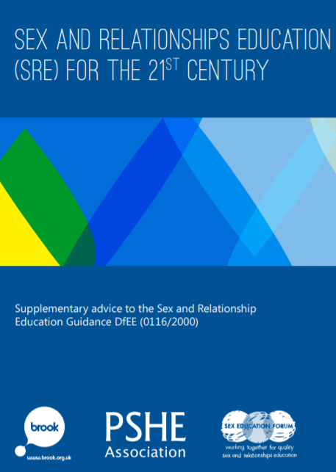
Why is Relationships and Sex Education and Health Education so important?
Children are naturally curious about growing up, how their bodies work and how humans reproduce. Their questions need to be answered honestly, using language and explanations appropriate for their age and maturity, thus avoiding unnecessary mystery, confusion, embarrassment and shame.
Relationships and sex education addresses the questions and concerns raised by the biological facts – for example, exploring the feelings a new baby can bring, or the effect of puberty on friendships.
It provides balance to sometimes distorted messages about sex and gender roles in the media, and helps protect children by explaining boundaries and safety, and developing the language and understanding needed to recognise abusive behaviour and seek help. It also helps pupils to develop respectful and consensual attitudes and behaviours.
Brook, 2014 (supplementary guidance for DfE publication 2000)
Notes:
READ SLIDE
These are all incredibly important points for why children should learn about their growing and changing bodies and about how a baby is made and born. We all know children are naturally curious. Children want to have their questions answered in a safe environment where they can feel relaxed enough to ask questions and engage with these important biological facts of life. Often during RSE and Health education lessons, we’ve found children open up and feel safe enough to ask further questions on these subjects.

Slide 9
Why is Relationships and Sex Education and Health Education so important?
High quality RSE and Health Education helps create safe school communities in which pupils can grow, learn, and develop positive, healthy behaviour for life. It is essential for the following reasons,
• Children and young people have a right to good quality education, as set out in the United Nations Convention on the Rights of the Child.
• Ofsted say, “Children and young people want to be prepared for the physical and emotional changes they undergo at puberty, and young people want to learn about relationships” (Ofsted, 2012).
• RSE plays a vital part in meeting schools’ safeguarding obligations. Ofsted is clear that schools must have a preventative programme that enables pupils to learn about safety and risks in relationships.
• Schools maintain a statutory obligation under the Children Act (2004) to promote their pupils’ wellbeing, and under the Education Act (1996) to prepare children and young people for the challenges, opportunities and responsibilities of adult life.
A comprehensive RSE programme can have a positive impact on pupils’ health and wellbeing and their ability to achieve, and can play a crucial part in meeting safeguarding obligations.
Notes:
Feel free to pause the video here and have a read through this slide.

Slide 10
Right to Withdraw from Sex Education (but not Relationships or Health Education)
Sex Education is not compulsory in primary schools, therefore parents/carers have the right to request that their child be withdrawn from the sex education element of our Relationships and Sex education programme of study.
At Herne, we welcome a meeting with parents/carers who would like to withdraw their child from the sex education element of our Relationships and Sex education programme of study. A discussion with the head teacher and subject leader can be arranged. This will help us to ensure the wishes of the parents/carers are understood, but also to clarify the nature and purpose of the taught curriculum at Herne. It is important to us that you understand the benefits of receiving this important education and any detrimental effects that withdrawal might have on the child. This could include any social and emotional effects of being excluded, as well as the likelihood of the child hearing their peers’ version of what was said in the classes, rather than what was directly said by the teacher in a safe, non-judgemental environment.
The Department for Education continues to recommend therefore that all primary schools should have a sex education programme tailored to the age and the physical and emotional maturity of the pupils. It should ensure that both boys and girls are prepared for the changes that adolescence brings and – drawing on knowledge of the human life cycle set out in the national curriculum for science - how a baby is conceived and born.
https://www.herne.hants.sch.uk/_site/data/files/documents/FA23803339473C417D1D3504F978F8D9.pdf (link to our RSE and Health Education Policy)
Notes:
As you are now aware, Relationships and Health Education are statutory in primary schools therefore children cannot be withdrawn from this part of the PSHE curriculum.
However..READ SLIDE
This link is just a link to our RSE and Health Education Policy at Herne.
Just to clarify the sex education element will only be taught in Year 6. However, as you can appreciate, children are curious and questions about sexual intercourse do get asked in earlier years. We know this from experience. When this arises, teachers will answer their questions in an age appropriate way adhering to the Herne School RSE & Health Education Policy.
I am going to stop here and there will be a third video where you can find out more about our pedagogy, resources and how we create that safe climate for learning.

Slide 11
Relationships, Sex and Health Education Parent/Carer Information Part 2 2023
Notes:
Welcome back to part two of the Relationships, Sex and Health Education Parent and Carer Information Presentation!
In this sequel we will be discussing the objectives, pedagogy, climate for learning, resources and other important elements of the curriculum.

Slide 12
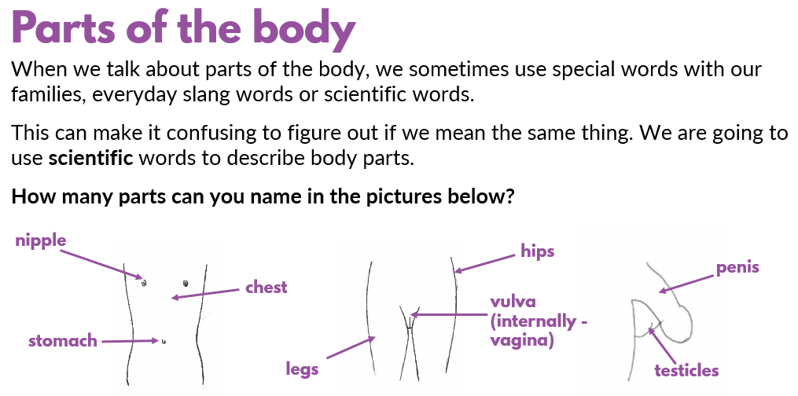
Pedagogy
At Herne, children will be taught Relationships, Sex and Health Education as part of a timetabled, graduated and age appropriate PSHE programme. Sex education, as already stated, is not taught until Year 6. The PDL leaders work closely with the Science and Computing leads to ensure that the subjects taught build on and develop their existing knowledge and understanding.
All of the compulsory subject content covered at Herne is age appropriate and developmentally appropriate. It is taught sensitively and inclusively, with respect to the backgrounds and beliefs of pupils and parents/carers while always with the aim of providing pupils with the knowledge they need to support their wellbeing, health and understanding of safe, healthy relationships.
Class teachers are responsible for delivering the RSE curriculum as they are best placed to do so. The class teachers know their pupils well and have built a rapport with the learners in their class. Teachers at Herne have had training from the PDL leads and are experienced, professional and sensitive in their delivery of age appropriate content.
Children will be taught using a variety of stimulus and resources:
Matching games
Labelling activities
Extracts from books
Class discussions
Interactive whiteboard activities
Video clips
Notes:
READ SLIDE

Slide 13
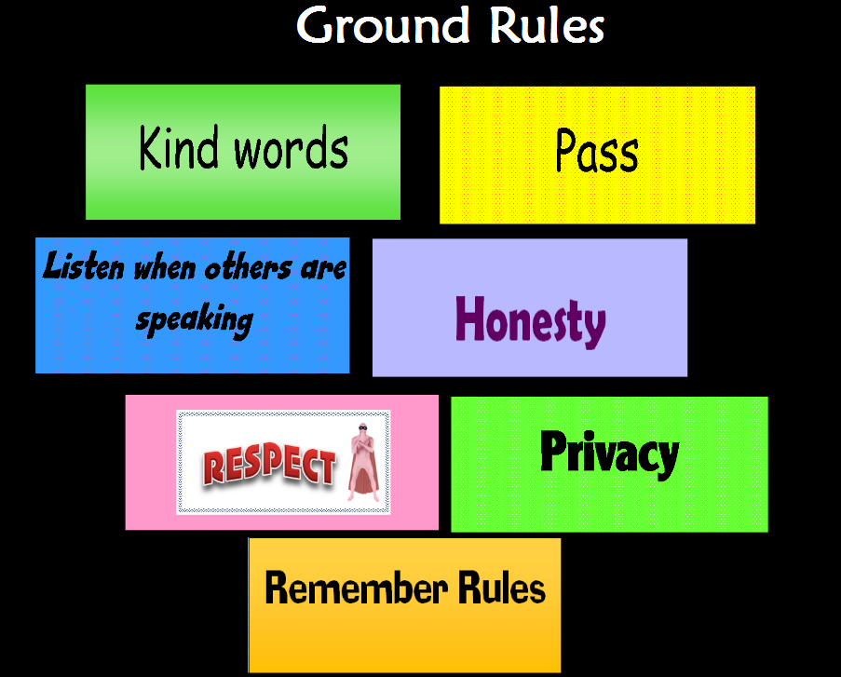
Climate for Learning
Ground Rules
Anonymous question Box (‘ask-it basket’)
Sensitive, age appropriate delivery
Safe, reassuring environment
Distancing the learning
Reassuring children of safe people they can talk to (where to access help)
Notes:
Before any of our PDL lessons, we establish a safe and comfortable environment. As a whole class we generate ground rules together, this is a really important part of distancing the learning so children are aware not to bring up personal stories or ask questions about personal experiences. It also is a very powerful way to enable everyone to feel comfortable and safe at the beginning of the lesson (children are very familiar with and respectful of ground rules as all teachers do this at the start of most PDL lessons). The delivery of relationships and sex education is taught through our graduated programme so it is age appropriate, taught in a factual and non-judgemental way, allowing scope for children to ask questions in a safe environment.
RSE is taught by the child’s class teacher with at least one other adult present (generally the class LSA). This is important because the children have a good rapport with their class teacher who knows the children well at this stage in their learning and are the best people placed to support them. The lessons will be carried out in class with their usual classmates. We do not split the children into gendered groups as research suggests that it is important they are with children and adults they are familiar with and therefore will hopefully feel most comfortable and secure with. The DfE inform that all children should learn about the changes that happen to both males and females. This is a key part of understanding one another, being respectful towards one another and understanding the changes their fellow pupils may be experiencing.

Slide 14
Arrangements for children with Special Educational Needs and Disabilities (SEND)
RSE and Health Education must be accessible for all pupils.
When planning our RSE and Health Curriculum we ensure we take into consideration the needs of pupils with SEND.
Therefore we may tailor our programme in order to make it accessible and age appropriate for individual children’s needs.
As with all teaching, we ensure our RSE and Health curriculum is sensitive, age-appropriate, developmentally appropriate and delivered with reference to the law.
Notes:
READ SLIDE: As with all curriculum subjects, RSE and Health Education must be accessible for all pupils. When planning our RSE and Health Education curriculum we ensure we take into consideration the needs of pupils with SEND. Therefore we may tailor our programme in order to make it accessible and age appropriate for individual children’s needs. As with all teaching we ensure our RSE and Health curriculum is sensitive, age appropriate, developmentally appropriate and delivered with reference to the law.

Slide 15
Faith Groups and Parental Feedback
At Herne, it is important to us that we have, a good understanding of our pupils’ faith backgrounds and positive relationships between the school and local faith communities to help to create a constructive context for the teaching of these subjects.
The religious background of all pupils are taken into account when planning teaching. We aim for the topics that are included in our curriculum to be appropriately and sensitively handled.
At Herne we ensure we comply with the relevant provisions of the Equality Act 2010, under which religion or belief are amongst the protected characteristics.
The DfE states that, “In all schools, teaching should reflect the law (including the Equality Act 2010) as it applies to relationships, so that young people clearly understand what the law allows and does not allow, and the wider legal implications of decisions they may make.”
If any parents/carers would like to consult with us about our Relationships, Sex and Health Education programme, we welcome your feedback and working in partnership with you.
Notes:
READ SLIDE

Slide 16
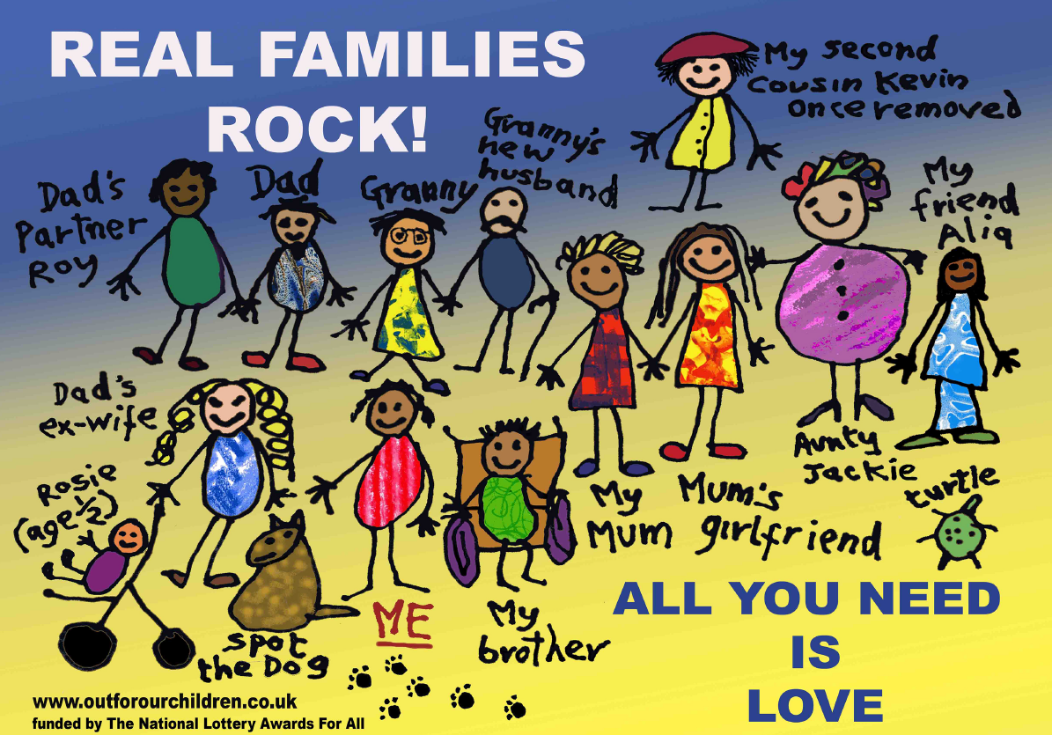
Lesbian, Gay, Bisexual and Transgender + (LGBT+)
The DfE states, “In teaching Relationships Education and RSE, schools should ensure that the needs of all pupils are appropriately met, and that all pupils understand the importance of equality and respect. Schools must ensure that they comply with the relevant provisions of the Equality Act 2010, (please see The Equality Act 2010 and schools: Departmental advice), under which sexual orientation and gender reassignment are amongst the protected characteristics.”
“Schools should ensure that all of their teaching is sensitive and age appropriate in approach and content. At the point at which schools consider it appropriate to teach their pupils about LGBT, they should ensure that this content is fully integrated into their programmes of study for this area of the curriculum rather than delivered as a standalone unit or lesson. Schools are free to determine how they do this, and we expect all pupils to have been taught LGBT content at a timely point as part of this area of the curriculum.”
At Herne, we are committed to developing global citizens who respect diversity and demand equality for all. Therefore we see it as our duty to ensure that LGBT+ communities are represented throughout our curriculum and not just our Personal Development Learning (PDL) curriculum.
We live in a diverse society and we serve a diverse community. It is essential that every child and family feels seen and represented through our teaching and resources.
Every child we teach should be able to see themselves and their family reflected in the resources we present to them.
Therefore our Relationships, Sex and Health Education aims to be inclusive and representative of the LGBT+ community taking into consideration the Equality Act 2010 and the protected characteristics.
Our coverage of LGBT⁺ relationships is age appropriate and sensitively delivered in line with the Department for Education’s guidance.
Notes:
The quotes that you can see are taken from the Department for Education statutory guidance on RSE and Health Education. Pause if you need time to read these quotes.
READ SLIDE

Slide 17
Year 4 Relationships and Health Education
Primary schools must have regard to the Department for Education statutory guidance on preparing pupils for the physical and emotional changes of puberty before they experience them. For this reason, it has been recommended by the PSHE Association (signposted by the DfE) that teaching about puberty should begin in Year 4. Therefore children at Herne are taught how their bodies develop and change during puberty in the Summer term of Year 4.
The following content is covered in our Y4 Growing and Changing unit.
In this unit pupils will learn,
the process of growing from birth to old age
the external genitalia and internal reproductive organs
how to manage the physical changes that happen during puberty, including periods and wet dreams
how to maintain personal hygiene during puberty
how and why emotions may change during puberty
where to get appropriate help, advice and support in relation to puberty
the importance of good sleep
Notes:
Historically, we have previously taught Puberty in Year 5, however….READ SLIDE
All children will learn the entirety of the curriculum including changes that occur to both males and females.

Slide 18
Why teach Puberty in Year 4?
“It is essential to teach about puberty before pupils experience it—to ensure that their physical, emotional and learning needs are met and that they have the correct information about how to take care of their bodies, their emotions and understand how to keep themselves safe. This includes being able to tell someone about behaviour that worries them or makes them feel uncomfortable.”
“By teaching about puberty you are helping to safeguard pupils. Providing accurate information about the physical and emotional changes that take place during puberty is extremely important. By understanding their bodies and the changes they will experience, pupils will be confident in knowing how to respect and care for their own bodies. The opportunities to explore changing feelings will ensure that they are prepared for adulthood and will lay down the foundation for more complex learning on sexual and reproductive health later on in their education.”
(Medway, 2018)
Notes:
So…READ TITLE
At Herne, we have taken the guidance from the DfE, PSHE ASSOCIATION, Brook and Medway.
READ SLIDE

Slide 19
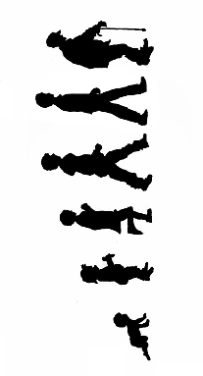
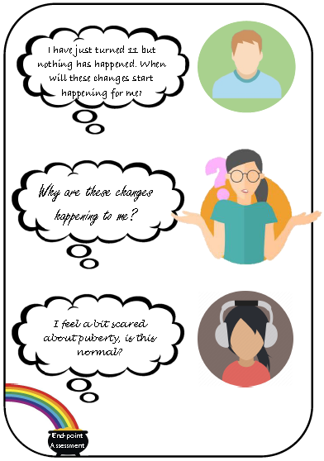
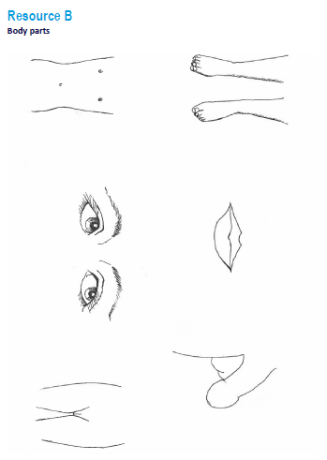
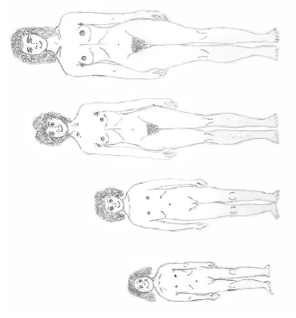
Examples of resources Year 4 – Growing and Changing (covering Puberty)
Notes:
On the following slides are several examples of the resources used in the Year 4 Growing and changing unit.

Slide 20
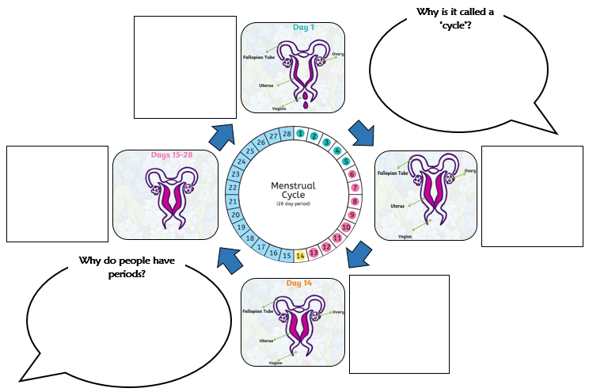
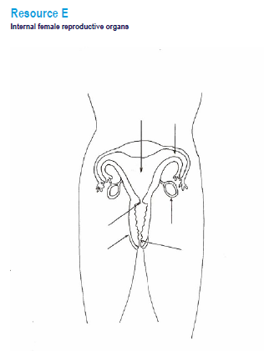
Examples of resources Year 4 – Growing and Changing (covering Puberty)
Notes:
We try to use a variety of resources including videos with real children's responses to questions about puberty.

Slide 21
Examples of resources Year 4 – Growing and Changing (covering Puberty)
Notes:
On this slide is a video taken from one of the PSHE Association accredited resources which talks through menstruation.

Slide 22
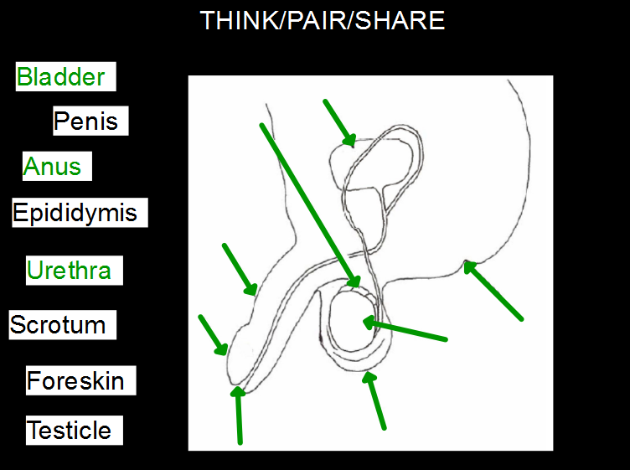
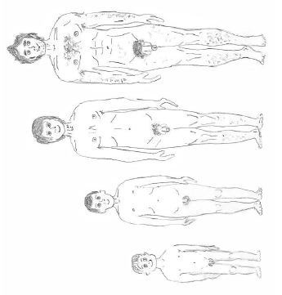
Examples of resources Year 4 – Growing and Changing (covering Puberty)
Notes:
As mentioned, children will be required to use the correct scientific language for parts of the body.

Slide 23
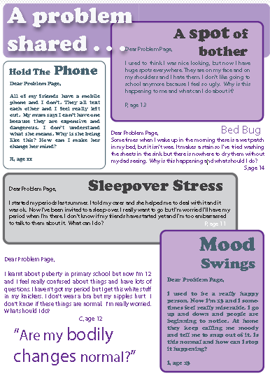
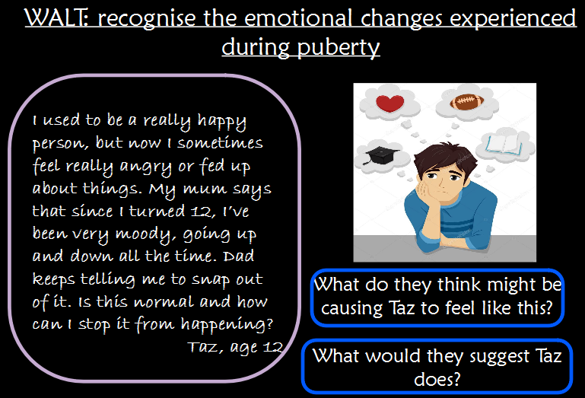
Examples of resources Year 4 – Growing and Changing (covering puberty)
Notes:
The use of problem pages shown here, help to distance the learning from their own personal stories whilst still allowing them to discuss situations and experiences they may encounter as they grow and change.

Slide 24
Relationships, Sex and Health Education Parent/Carer Information Part 3 2023
Notes:
Welcome back and apologies that this has turned into a trilogy. Thank you to our dedicated fans who have made it to part three! We promise that this is the last part!

Slide 25
Year 6 Relationships, Sex and Health Education
At Herne, we have historically taught an age appropriate Relationships, Sex and Health Education programme to our Year 6 children. In doing so we have met the current recommendation by the DfE that, “all primary schools should have a sex education programme tailored to the age and the physical and emotional maturity of the pupils. “
We will continue to teach our Relationships, Sex and Health Education programme with some more updated and current resources accredited by the PSHE Association.
Notes:
READ SLIDE

Slide 26
EDIT Year 6 Relationships, Sex and Health Curriculum
The children will be taught the statutory objectives outlined by the Department for Education within the Relationships and Health Education Curriculum as well as content from the PSHE Association’s Programme of Study (signposted by the DfE):
In this unit pupils will learn,
about stereotypes and how they influence behaviour (specifically gender stereotypes)
how to manage change – new roles and responsibilities as they grow up
how to manage the physical and emotional changes that
happen during puberty (periods, wet dreams, masturbation)
how to take responsibility for personal hygiene during adolescence
about the role of trust, respect and boundaries in healthy relationships (including friendships and family)
about seeking and giving/not giving permission in different situations
about adult relationships and the human life cycle
about human reproduction; how a baby is made and how it grows
how to manage the risks of communicating online with others not known face-to-face
strategies to respond to harmful behaviour, including online
how to report concerns and access help or advice
During our Q and A sessions in class sometimes children may ask questions about topics not covered such as contraception. If we feel it is age appropriate and safe to discuss then we will address these areas in a sensitive way.
Notes:
READ SLIDE
The bullet point in bold: READ… is the one part of the Year 6 Relationships, Sex and Health Education curriculum that parent’s have the right to withdraw their child from. The rest of the unit’s content is part of the statutory curriculum as laid out by the DfE.

Slide 27
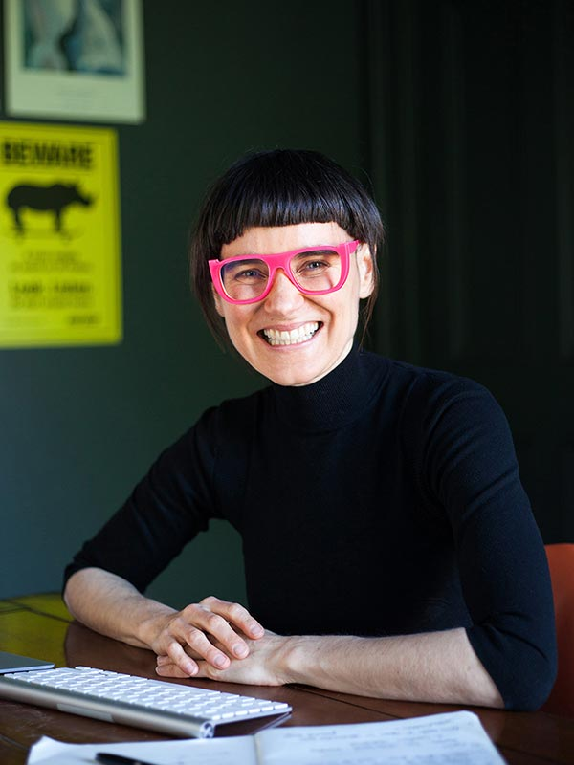
Sarah Sproule – Leading educator in RSE and Health Education Video links
Click here to see video - Vimeo Password is: talking123
“Feeling awkward, are you?
I’m with you! If you’re feeling overwhelmed or even guilty because you’re having trouble talking with your child about puberty, bodies and sex, you’re not alone. Most of us grew up in homes with adults who were uncomfortable having “the talk,” and so we learnt to feel awkward about it, too.
I was a kid who ABSOLUTELY grew up feeling too embarrassed and unsure to talk about anything to do with sex at all.
So here's one thing I know.
Talking about awkward stuff is hard to do with kids.
And here's why.
Because we haven't been taught to be comfortable about puberty, bodies and sex.
For the past 5 years, I've been helping parents overcome the awkward.
We’ve learnt to start conversations, answer questions, stay connected with our kids as they grow, and provide a culture of openness and acceptance at home. Our kids have grown in confidence and self-respect, and they see us parents as their go-to resource when they need guidance.
Most parents want to support their children as they grow toward puberty and mature into adulthood. And they want to raise kids who can respect themselves, speak up for what it right and respect the people around them.
I can help!” Sarah Sproule
Notes:
One of the frequently asked questions taken from the DfE guidance was Q: Will my child be taught sex education at primary? This is too young.
SARAH SPROULE a leading expert in Relationships and Sex Education has made some really useful videos to assist parents and carers with having sensitive and gentle conversations around this subject.
She says, “Many adults think that conversations around sex need to be about making babies (creating new humans) but the vast majority of sex that happens in the world and the vast majority of sex that humans have is not to do with making new humans. The sex that people have can be to do with companionship, love, closeness, pleasure or affection there are a vast majority of reasons why humans have sex. There are also people who choose not to have sexual relationships but experience pleasure through touching their own body. There are so many fabulous important questions that need to be had with children. Because when we only talk about sex through the context of making babies we are leaving out a whole section of important knowledge that children can gather over time that is going to help create healthy, positive, strong, wonderful relationships as they grow up. Because knowing that sex is something we can have with someone else because it feels good is one of the important building blocks about learning about consent. Imagine if our child didn’t know that sex was meant to feel good, what are all the negative implications that could happen as a result of that? While conversations about how sperms and eggs get together to make babies are important, there are a vast array of other important conversations that need to take place.”
Sarah Sproule video links are on the next slide of the PowerPoint if parents and carers would like to watch more. It may assist you in having these important conversations with your children, should you choose to.
You can access this PowerPoint from our school website. You will need to do so to in order to use the link shown on this slide. Click on the link to access the videos created by Sarah Sproule who is a leading expert in Relationships and Sex education and Health education. These videos may assist parents/carers who choose to have these important conversations with their children.
As shown on the previous slide, our curriculum has a large focus on children’s changing bodies, healthy, positive relationships, trust, respect and boundaries before we begin to talk about sexual intercourse.

Slide 28
EDIT Year 6 Puberty and Reproduction Unit Overview
Notes:
Here is the… READ TITLE with images of the sites where we have accessed our resources. As mentioned the majority are accredited by the PSHE Association.

Slide 29
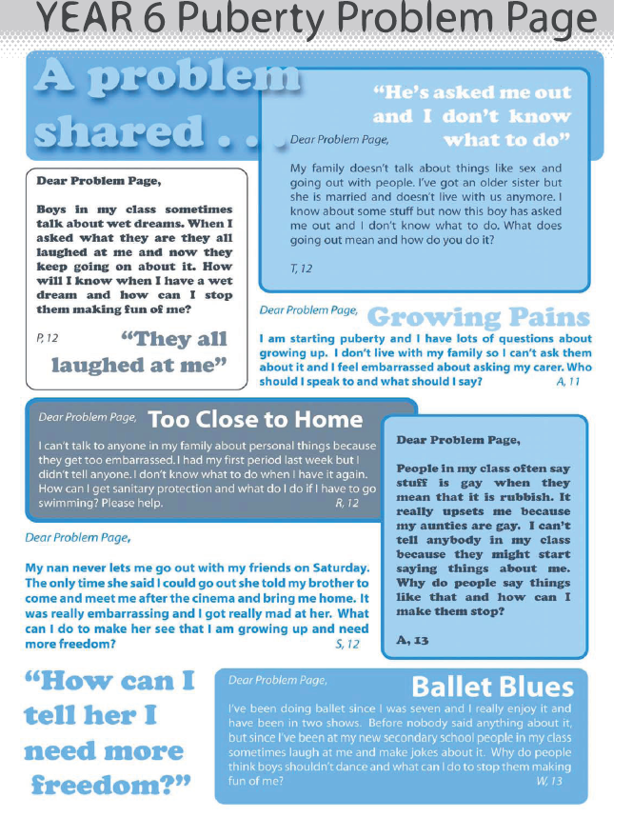
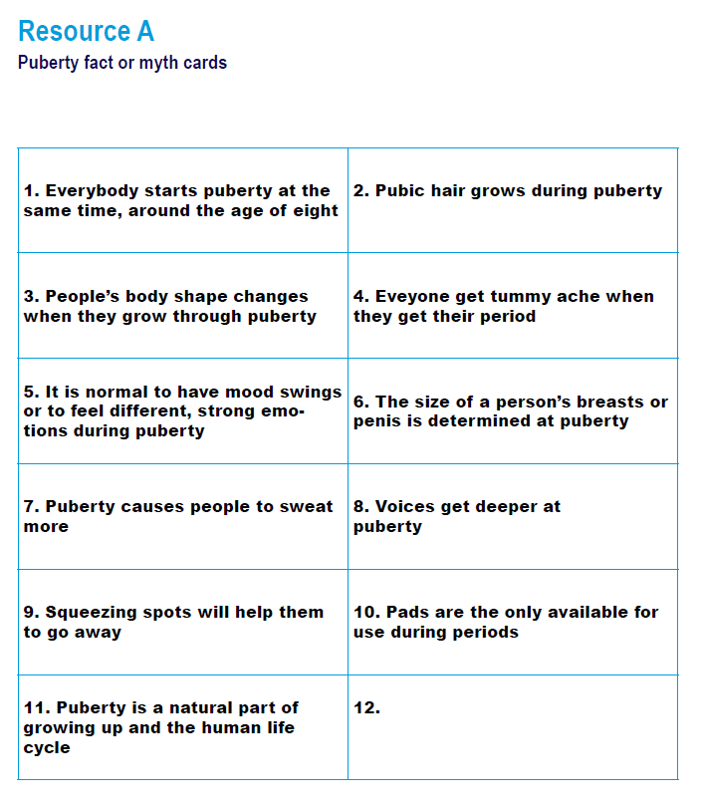
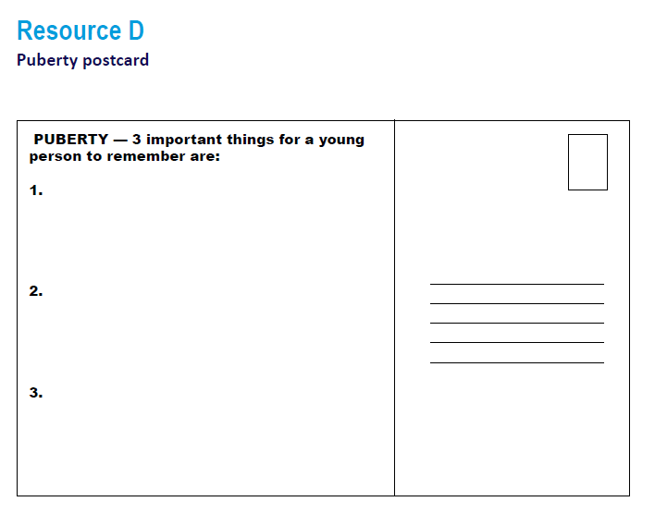
Examples of resources Year 6 – Puberty and Reproduction
Some of the resources used when teaching puberty.
Notes:
The use of myth and fact cards shown here, not only help to distance the learning as mentioned earlier but help to clear up any misconceptions they may have.

Slide 30
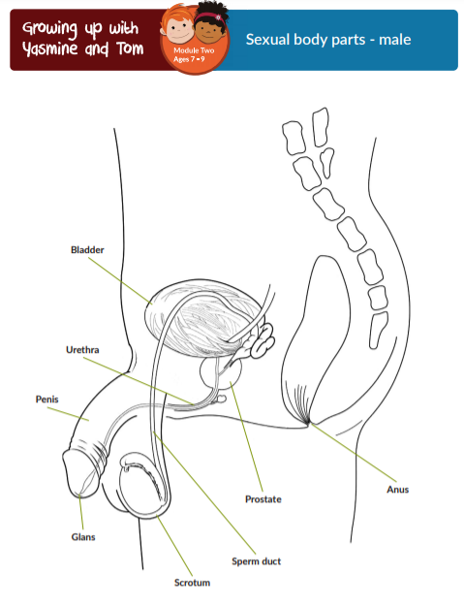
Some of the resources used when teaching puberty.
Notes:
Labelling the correct terminology is again used within this unit. Whilst we highlight that children and adults sometimes use lots of different words for genitals, in these lessons we will teach the scientifically correct words for the human body. We will discuss with the children that some slang words can be confusing (and sometimes even rude and disrespectful).

Slide 31
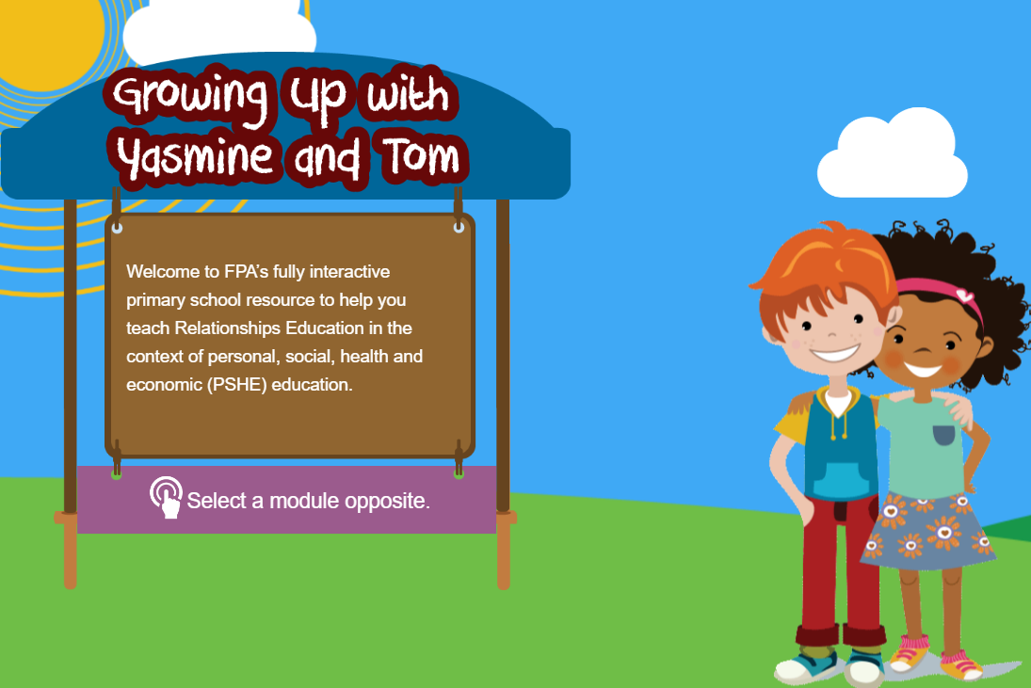
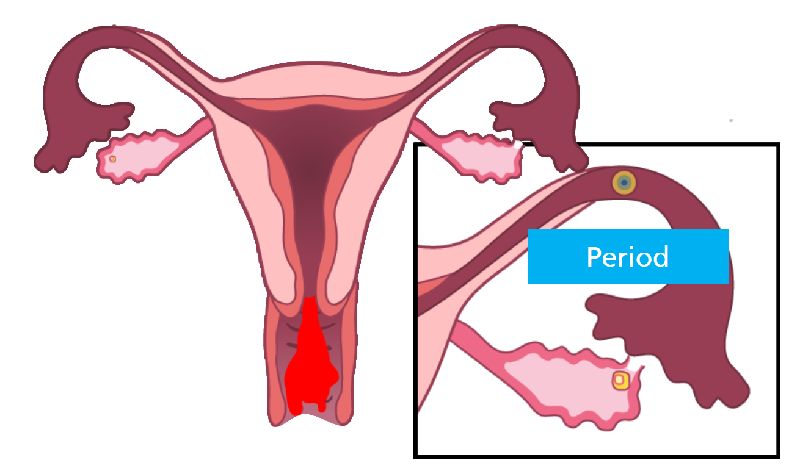
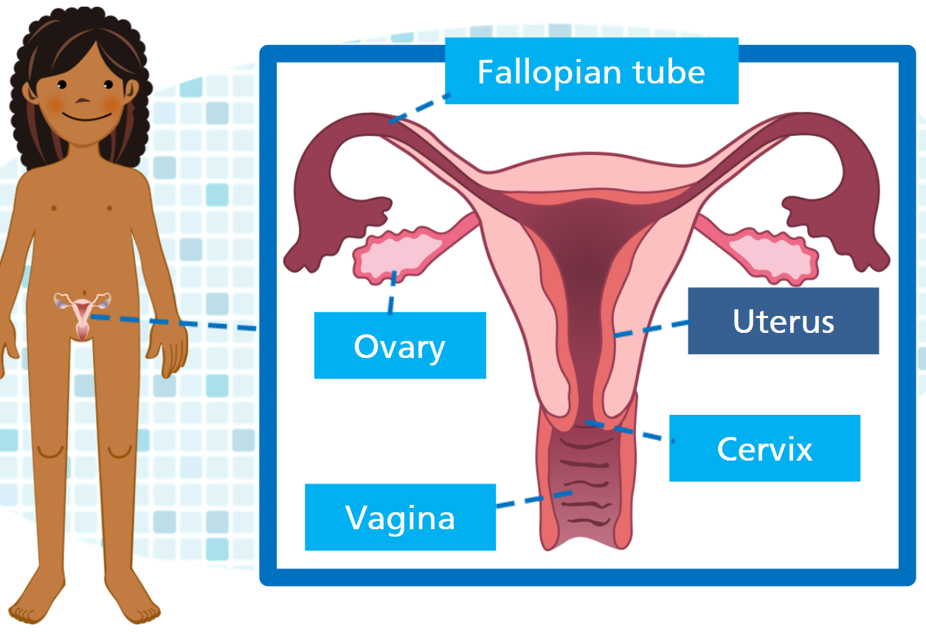
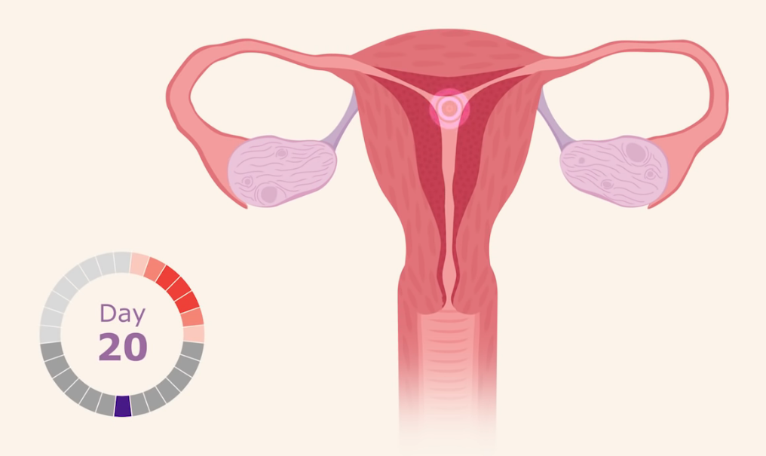
Examples of resources Year 6 – Puberty and Reproduction
Some of the resources used when teaching about the menstrual cycle.
Notes:
Here are some more resources used when teaching about the menstrual cycle. We also use interactive whiteboard clips as screenshotted here. These are taken from a resource called Yasmine and Tom.

Slide 32
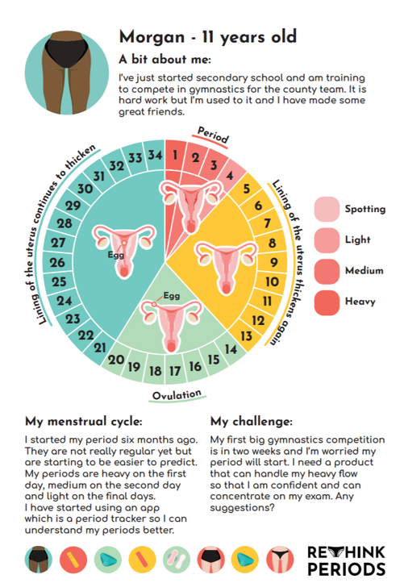
Examples of resources Year 6 – Puberty and Reproduction
Some of the resources used when teaching about the menstrual cycle.
Notes:
Here are some more resources used when teaching about the menstrual cycle. Here are resources taken from City to Sea which are resources accredited by the PSHE Association.

Slide 33
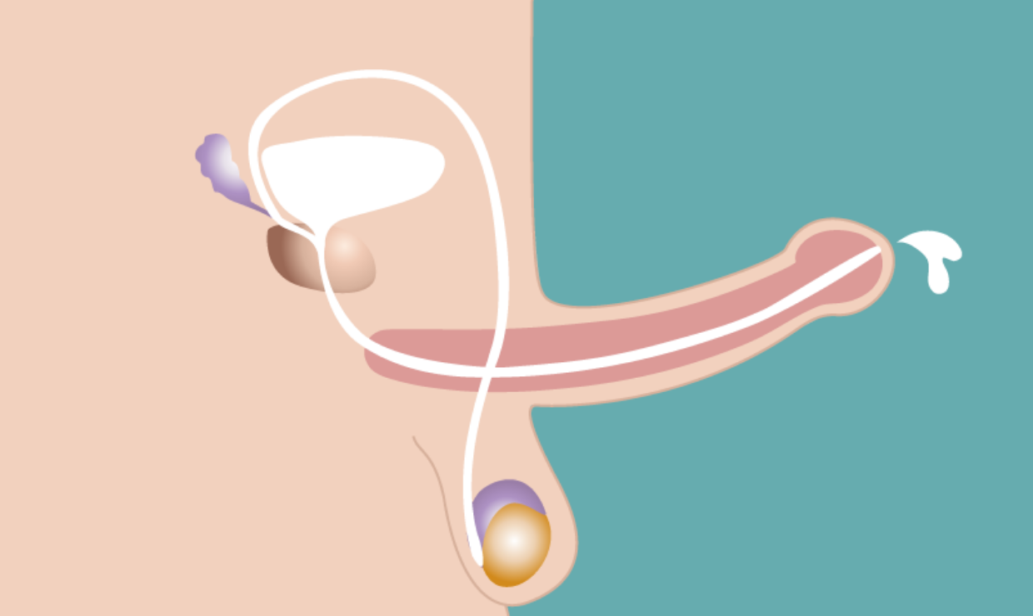
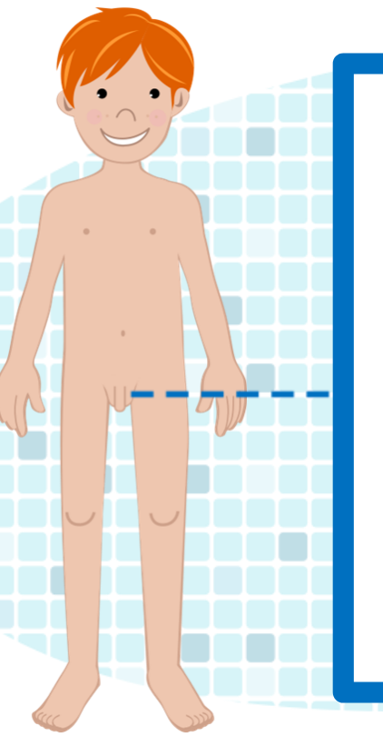
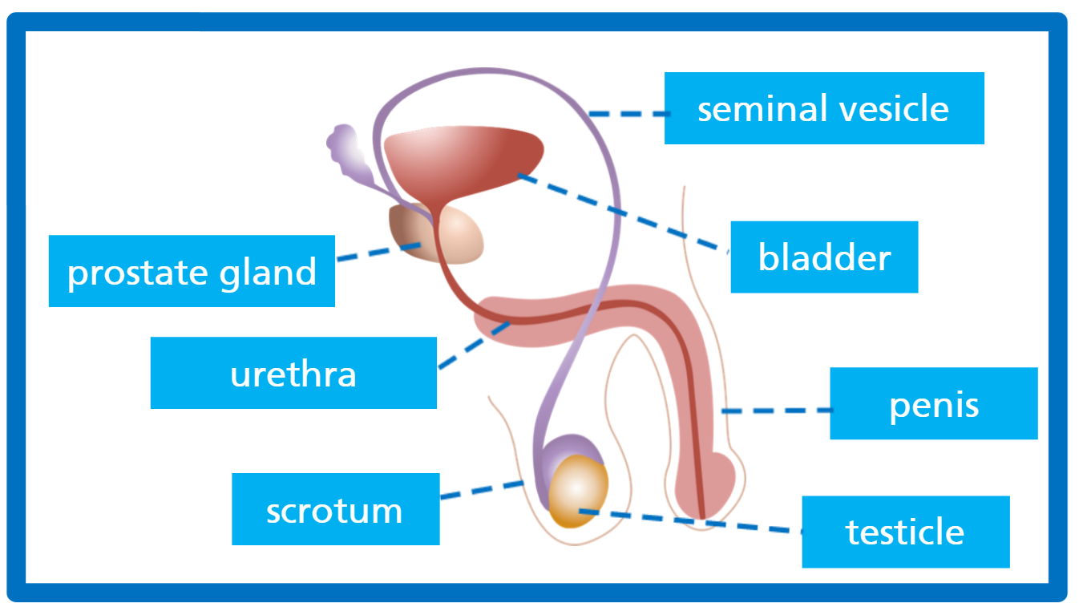
Examples of resources Year 6 – Puberty and Reproduction
Some of the resources used when teaching about changes wet dreams.
Notes:
Here are some more resources used when teaching about changes and wet dreams. Here are some more screenshots of interactive whiteboard clips.

Slide 34
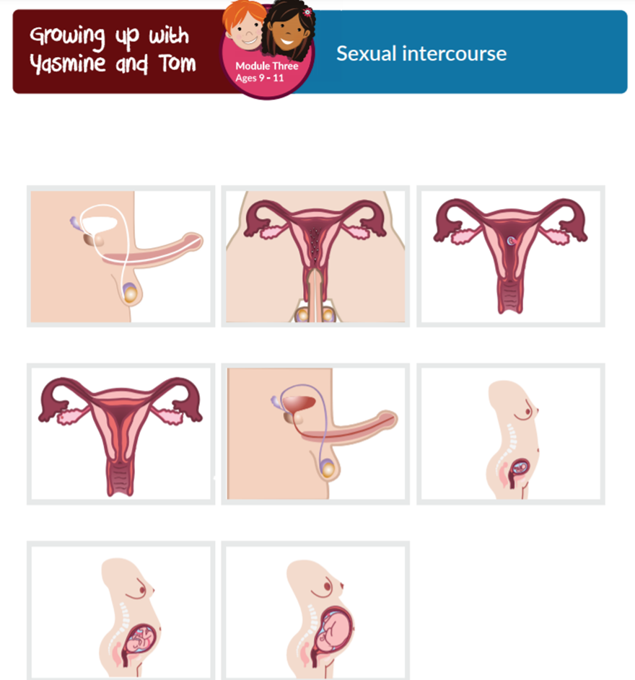
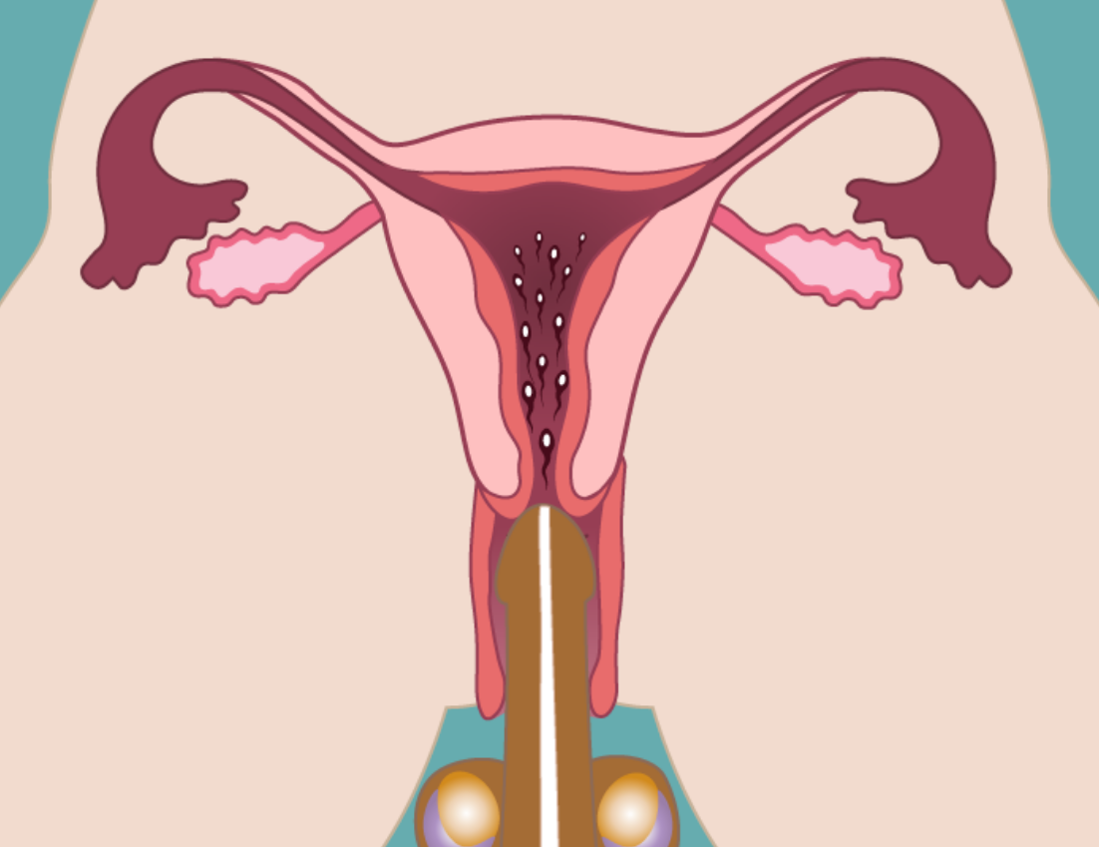
Examples of resources Year 6 – Puberty and Reproduction
Some of the resources used when teaching about sexual intercourse and making a baby.
Notes:
Here is the interactive whiteboard clip we use for teaching about human reproduction in order to make a baby. This is taken from a PSHE Association accredited resource.

Slide 35
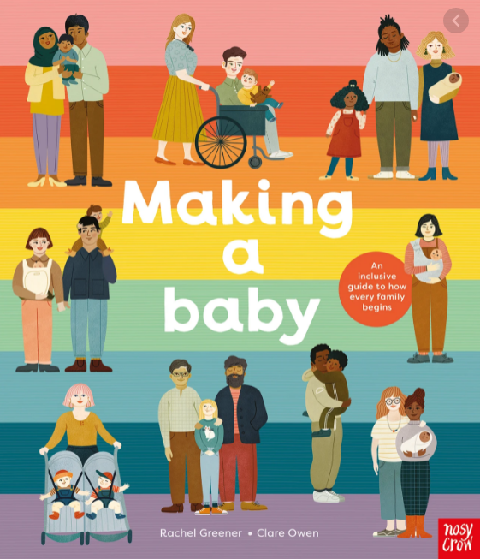
Examples of resources Year 6 – Puberty and Reproduction
An inclusive book used when teaching about making a baby and sexual intercourse.
Notes:
Here is an inclusive book we use when teaching about making a baby and sexual intercourse. It is a beautiful, inclusive book which discusses the many ways that parents/carers may go about making a baby or having a child such as through sexual intercourse, surrogacy, IVF and adoption.

Slide 36
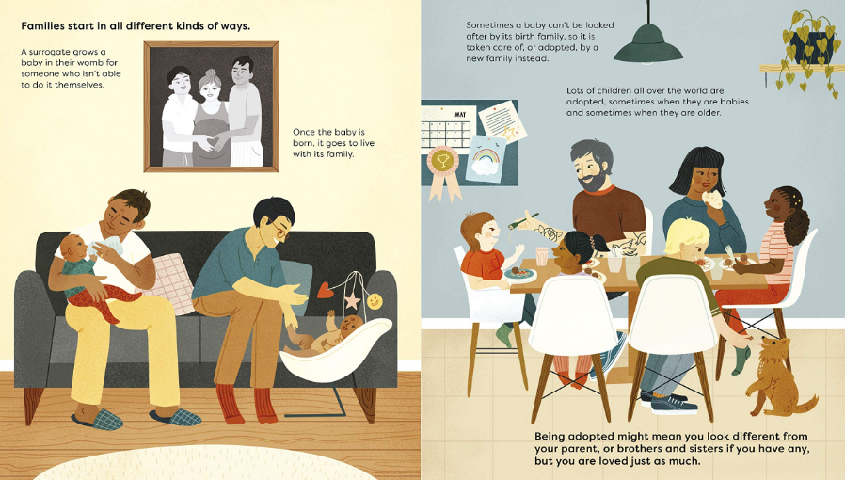
Examples of resources Year 6 – Puberty and Reproduction
Notes:
Here are some pages screenshotted from the book. Please feel free to pause if you’d like to read the pages from the book.

Slide 37
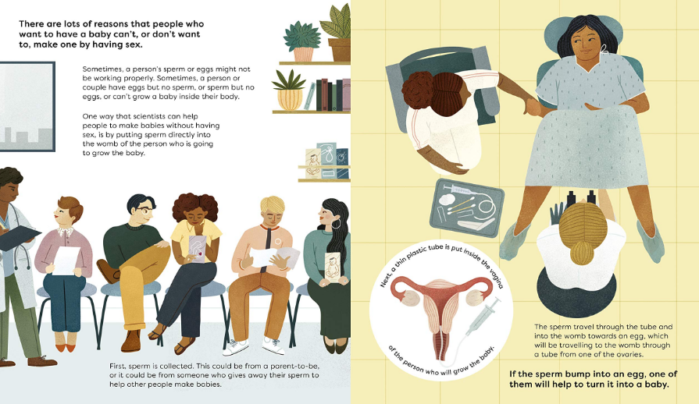
Examples of resources Year 6 – Puberty and Reproduction

Slide 38
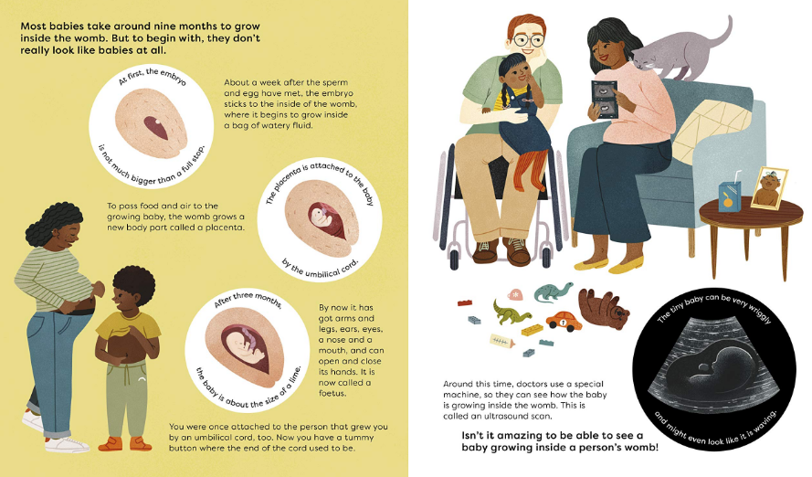
Examples of resources Year 6 – Puberty and Reproduction

Slide 39
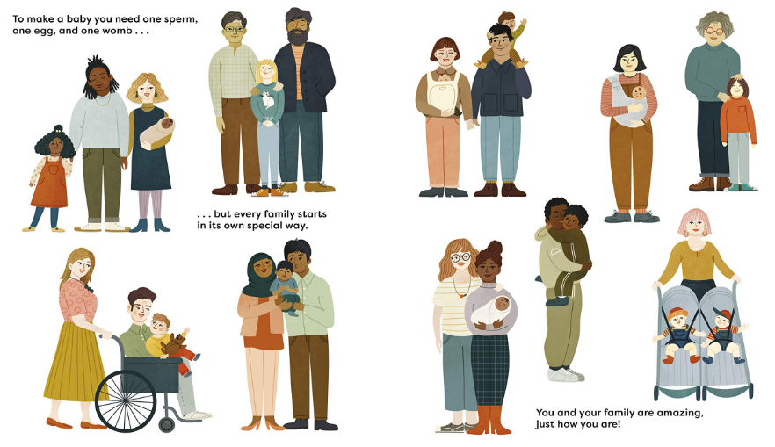
Examples of resources Year 6 – Puberty and Reproduction

Slide 40
Any Questions?
If you have any questions or concerns, or would like to offer feedback on our RSE and Health Education programme, please get in touch with the Senior Leadership Team or the PSHE Leader, Olivia Hepworth, via their email or through the school’s office via their admin email or telephone number.
If you would like to discuss the right to withdraw your child from the sex education element of our Relationships and Sex education programme of study in Year 6, please contact Mrs Hepworth and Mrs Sayers.
o.hepworth@hernejunior.com Mrs Hepworth (Teacher and PSHE Lead)
admin@hernejunior.com or 01730 263746 – Admin/School Office
s.sayers@hernejunior.com Mrs Sayers (Head Teacher)
Notes:
Thank you so much for taking the time to listen to our presentation on Herne’s RSE and Health Education curriculum.
Read Slide.

Slide 41
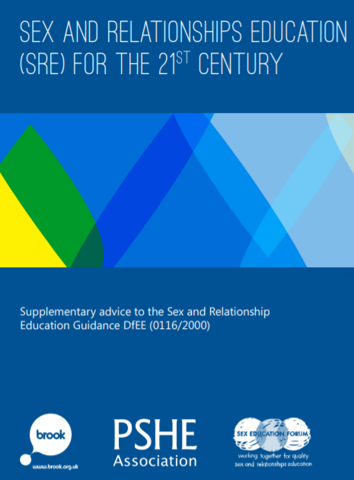
References
https://assets.publishing.service.gov.uk/government/uploads/system/uploads/attachment_data/file/908013/Relationships_Education__Relationships_and_Sex_Education__RSE__and_Health_Education.pdf
DfE ‘Relationships Education, Relationships and Sex Education (RSE) and Health Education’ (Crown copyright 2019)
https://www.fpa.org.uk/system/files/elearning/pdfs/common_v2/Essential%20guide%20for%20teachers.pdf
(FPA - Yasmine and Tom, Essential Guide for Teachers, 2021)
https://www.herne.hants.sch.uk/_site/data/files/documents/FA23803339473C417D1D3504F978F8D9.pdf
(Herne’s RSE & Health Education Policy - Herne Junior School Website 2021)
https://www.pshe-association.org.uk/system/files/SRE%20for%20the%2021st%20Century%20-%20FINAL.pdf.pdf
(Sex and relationships education (SRE) for the 21st century – Brook, PSHE Association and Sex Education Forum)

